Slide 1
Introduction to WDDN
Prepared for Vth semester DDU-CE students 2019-20 WDDN
Apurva A Mehta

Slide 2
Chess was invented in ____.
Notes:
Chess was invented in India.

Slide 3
What is .NET?
Software? Language? API?
Framework?
NET is actually a cluster of technologies that are designed to help developers build a variety of different types of applications.
Notes:
API
a set of functions and procedures allowing the creation of applications that access the features or data of an operating system, application, or other service.
In computer programming, a software framework is an abstraction in which software providing generic functionality can be selectively changed by additional user-written code, thus providing application-specific software. A software framework provides a standard way to build and deploy applications.
With .NET, you can use multiple languages, editors, and libraries to build for web, mobile, desktop, gaming, and IoT.

Slide 4
Types of Application
An Application can be :
Web Application
Windows Application
Mobile Application
Web Service
Command Line Application

Slide 5
Before ASP.NET
Did not scale well
Provide little more than a bare-bones programming environment
Tedious and error-prone
Notes:
Early web development platforms had two key problems. First, they didn’t always scale well. As a result, popular
websites would struggle to keep up with the demand of too many simultaneous users, eventually crashing or
slowing to a crawl. Second, they provided little more than a bare-bones programming environment. If you
wanted higher-level features, such as the ability to authenticate users or read a database, you needed to write
pages of code from scratch. Building a web application this way was tedious and error-prone.

Slide 6
ASP.NET
ASP(Active Server Page )
Specific Subset of .NET Technologies used to build web applications
Program dynamic web pages
Free from low-level implementation details
Normally C# Language is used to build web applications using ASP.NET.
Notes:
To counter these problems, Microsoft created higher-level development platforms—first ASP and then
ASP.NET. These technologies allow developers to program dynamic web pages without worrying about the
low-level implementation details. Even better, ASP.NET is stuffed full of sophisticated features, including tools
for implementing security, managing data, storing user-specific information, and much more. And amazingly
enough, it’s even possible to program an ASP.NET page without knowing anything about HTML (although a little
bit of HTML smarts will help you build your pages more quickly and effectively).

Slide 7
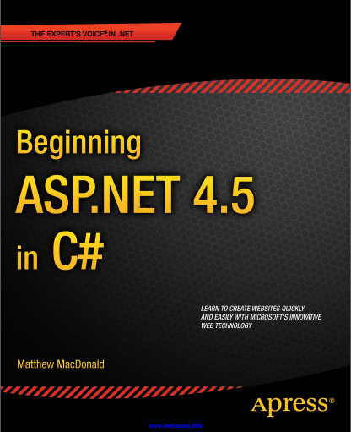
Text Book
Author : Matthew MacDonald

Slide 8
Objectives of the Course
Develop in depth understanding about .NET framework and its core components
Learning core C# language features
Getting familiar with Visual Studio IDE
Learning Web controls to develop basic web applications
Advance web development topics such as Session management, Security, etc.

Slide 9
Cont.
Interacting with SQL Server Database and building data driven applications.
Developing MVC applications with Entity framework
Learning basics of IIS Server and deployment process of .NET application.

Slide 10

Web site vs Web App.
Notes:
So what’s the difference between a website and a web application? Not a lot…or everything. It’s mostly a matter of perspective and semantics and is largely opinion based. Even if you wanted to ask Wikipedia (and who doesn’t?), you’d get definitions for a web application and a website that sound awfully similar.
https://www.seguetech.com/website-vs-web-application-whats-the-difference/
https://stackoverflow.com/questions/8694922/whats-the-difference-between-a-web-site-and-a-web-application

Slide 11
Cont.
A website is informational
A web application is interactive
Normally Web sites have static content while Web Apps are interactive
A web application is a web site that the user can control
Notes:
Most people will use the term website for just about everything, and they’re not wrong. If what you’re talking about is something that exists out on the internet and you get there with your web browser, then it’s a website. However, if you ask someone in IT, you’re just as likely to hear them describe something like that as a web application. If you asked ten different IT professionals to explain the difference between the terms, you’re probably going to get ten different answers, but in the opinion of this IT professional, the difference boils down to this:
A website is informational
A web application is interactive
A website is defined by its content, while a web application is defined by its interaction with the user.
Web site can be considered as subset of Web application
To illustrate the difference, let’s take the example of a restaurant’s web presence. If you visit the site for your local Chinese takeout joint and find nothing more than the hours of operation, a menu, directions from the nearest highway or a static map, and contact information listed then you’ve got yourself a website.
However, if you went out and visited a site like the one for P.F. Chang’s, you would find all the “static” information and then additional functionality. You can make a reservation, view a customized menu that includes prices at your local store, order your food online, or purchase a gift card. This sort of interactivity is specific to a web application and is what differentiates it from a website. Put simply, a web application is a web site that the user can control.

Slide 12
Cont.
Website: https://ddu.ac.in/
Web application: https://mail.google.com
They are not entirely exclusive
egov?
moodle?

Slide 13
Web Development
HTML Page : Text + Elements
HTML forms allow web developers to design standard input pages
Server side, a custom application receives and processes the data
Notes:
An HTML document has two types of content: the text and the elements (or tags) that tell the browser how to format it

Slide 14


Client-side vs Server-side Web Application
Notes:
ASP.NET is designed first and foremost as a server-side programming platform. That means that all ASP.NET
code runs on the web server. When the ASP.NET code finishes running, the web server sends the user the final
result—an ordinary HTML page that can be viewed in any browser.
Server-side programming isn’t the only way to make an interactive web page. Another option is client-side
programming, which asks the browser to download the code and execute it locally, on the client’s computer. Just
as there are a variety of server-side programming platforms, there are also various ways to perform client-side
programming, from snippets of JavaScript code that can be embedded right inside the HTML of a web page, to
plug-ins such as Adobe Flash and Microsoft Silverlight.

Slide 15
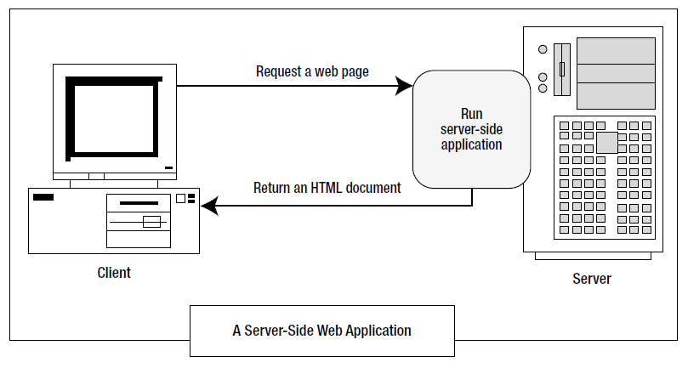
Server-side web application

Slide 16
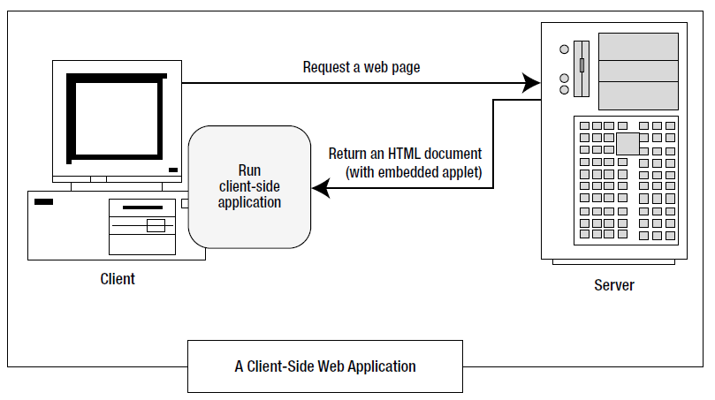
Client-side web application

Slide 17
Analysis
Server side programming works good but there may be scalability issues.
Issues in Client side programming :
Isolation
Security
Thin clients
Notes:
ASP.NET uses server-side programming to avoid several problems:
Isolation: Client-side code can’t access server-side resources. For example, a clientside
application has no easy way to read a file or interact with a database on the server
(at least not without running into problems with security and browser compatibility).
Security: End users can view client-side code. And once malicious users understand
how an application works, they can often tamper with it.
Thin clients: In today’s world, web-enabled devices such as tablets and smartphones
are everywhere. These devices usually have some sort of built-in web browsing
ability, but they may not support client-side programming platforms such as Flash or
Silverlight.
In recent years, there’s been a renaissance in client programming, particularly with JavaScript. Nowadays
developers create client-side applications that communicate with a web server to fetch information and perform
tasks that wouldn’t be possible if the applications were limited to the local computer. Fortunately, ASP.NET takes
advantage of this change in two ways:
JavaScript frills: In some cases, ASP.NET allows you to combine the best of client-side
programming with server-side programming. For example, the best ASP.NET controls
can “intelligently” detect the features of the client browser. If the browser supports
JavaScript, these controls will return a web page that incorporates JavaScript for a
richer, more responsive user interface. You’ll see a good example of this technique
with validation in Chapter 9.
ASP.NET’s Ajax features: Ajax is a set of JavaScript techniques used to create fast,
responsive pages with dynamic content. In Chapter 25, you’ll learn how ASP.NET lets
you benefit from many of the advantages of Ajax with none of the complexity.
However, it’s important to understand one fundamental fact. No matter what the capabilities of the browser,
the C# code that you write is always executed on the server. The client-side frills are just the icing on the cake.

Slide 18
.NET Framework version
.NET 1.0 : 2002-02-13
.NET 4.8 : 2019-04-18
Notes:
https://en.wikipedia.org/wiki/.NET_Framework_version_history

Slide 19
Programming language timeline
1950’s and 1960’s | FORTRAN, LISP, COBOL, BASIC,
1970’s | Pascal, C, Prolog, SQL,
1980’s | C++, MATLAB, Perl,
1990’s | Python, R, Java, JavaScript, PHP
2000’s | C#, TypeScript
Notes:
https://en.wikipedia.org/wiki/History_of_programming_languages

Slide 20
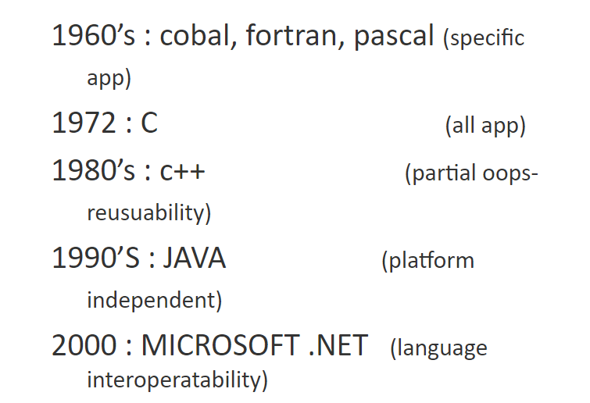
Programming Language Timeline

Slide 21
The Framework
C++
C#
VB.NET
Perl
J#
…
ASP .NET
Web Forms Web Services
Mobile Internet Toolkit
Windows
Forms
ADO .NET and XML
.NET Framework (Base Class Library)
Common Language Runtime
Operating System
Notes:
As you’ve already learned, the .NET Framework is really a cluster of several technologies:
The .NET languages: These include Visual Basic, C#, F#, and C++, although third-party
developers have created hundreds more.
The Common Language Runtime (CLR): This is the engine that executes all .NET
programs and provides automatic services for these applications, such as security
checking, memory management, and optimization.
The .NET Framework class library: The class library collects thousands of pieces of
prebuilt functionality that you can “snap in” to your applications. These features are
sometimes organized into technology sets, such as ADO.NET (the technology for
creating database applications) and Windows Presentation Foundation (WPF, the
technology for creating desktop user interfaces).
ASP.NET: This is the engine that hosts the web applications you create with .NET, and
supports almost any feature from the .NET Framework class library. ASP.NET also
includes a set of web-specific services, such as secure authentication and data storage.
Visual Studio: This optional development tool contains a rich set of productivity and
debugging features. Visual Studio includes the complete .NET Framework, so you
won’t need to download it separately.

Slide 22
.NET Framework Base Class Library
Prefabricated functionality for everything from reading an XML file to sending an e-mail message
Well-stocked programmer’s toolkit
Any .NET language can use the .NET class library’s features by interacting with the right objects.
.NET Framework (Base Class Library)
Common Language Runtime
Operating System
Notes:
.NET supplies a library of base classes that we can use to implement applications quickly
String handling, IO operations, graphics, text handling, file operations and many more
The .NET class library is a giant repository of classes that provide prefabricated functionality for everything
from reading an XML file to sending an e-mail message. If you’ve had any exposure to Java, you may already be
familiar with the idea of a class library. However, the .NET class library is more ambitious and comprehensive
than just about any other programming framework. Any .NET language can use the .NET class library’s features
by interacting with the right objects. This helps encourage consistency among different .NET languages and
removes the need to install numerous components on your computer or web server.
You can think of the class library as a well-stocked programmer’s toolkit. Microsoft’s philosophy is that it will
provide the tedious infrastructure so that application developers need only to write business-specific code. For
example, the .NET Framework deals with thorny issues such as database transactions and concurrency, making
sure that hundreds or thousands of simultaneous users can request the same web page at once. You just add the
logic needed for your specific application.

Slide 23
.NET Framework Data Access Layer
XML : universally adopted language for internet message passing.
ADO.NET : handling database connection and maintenance with front-end .NET technology.
ADO .NET and XML
.NET Framework (Base Class Library)
Common Language Runtime
Operating System
Notes:
XML – Extended mark-up language, is a universally adopted language for internet message passing.
ADO.NET : provides class for handling database connection and maintenance with front-end .NET technology.

Slide 24
.NET Framework ASP.NET & Windows Forms
ASP .NET
Web Forms Web Services
Mobile Internet Toolkit
Windows
Forms
ADO .NET and XML
.NET Framework (Base Class Library)
Common Language Runtime
Operating System
Notes:
Create application’s front-end – Web-based user interface, Windows GUI, Web services, …

Slide 25
.NET Framework Programming Languages
C++
C#
VB.NET
Perl
J#
…
ASP .NET
Web Forms Web Services
Mobile Internet Toolkit
Windows
Forms
ADO .NET and XML
.NET Framework (Base Class Library)
Common Language Runtime
Operating System
Notes:
Use your favorite language

Slide 26
.NET Framework Visual Studio .NET
C++
C#
VB
Perl
J#
…
Visual Studio .NET
Common Language Specification
ASP .NET
Web Forms Web Services
Mobile Internet Toolkit
Windows
Forms
ADO .NET and XML
.NET Framework (Base Class Library)
Common Language Runtime
Operating System

Slide 27

.NET Framework Common Language Runtime
Layer between OS and application written in any .NET specific language
CLR is a runtime environment
Also supports cross-language interoperability
Common Language Runtime
Operating System
Notes:
CLR is the heart and soul of the .net framework.
CLR is a runtime environment in which programs written in C# and other .NET language are executed.
It also support s cross-language interoperability.

Slide 28
.NET Framework Common Language Runtime
Main Function
Managed Code → Native Code
CLR’s JIT converts MSIL code into Native code at runtime
Notes:
CLR is the heart and soul of the .net framework.
CLR is a runtime environment in which programs written in C# and other .NET language are executed.
It also support s cross-language interoperability.
MSIL generated through managed code
Native Code is code compiled to processor-specific machine code.
Managed Code runs under a "contract of cooperation" with the CLR and it must supply the metadata necessary for the CLR to provide services such as memory management, cross-language integration, Code Access Security and automatic lifetime control of objects. All code based on Microsoft Intermediate Language (MSIL) executes as managed code.
Microsoft Intermediate Language (MSIL) is used as the output of a number of compilers and as the input to a Just-In-Time (JIT) compiler. The CLR includes several JIT compilers for converting MSIL to native code.

Slide 29
.NET Framework Common Language Runtime
Native Code
code compiled to processor-specific machine code.
Managed Code
must supply the metadata necessary for the CLR to provide services
all code based on Microsoft Intermediate Language (MSIL) executes as managed code.
Microsoft Intermediate Language (MSIL)
used as the output of a number of compilers and as the input to a Just-In-Time (JIT) compiler.
Notes:
CLR is the heart and soul of the .net framework.
CLR is a runtime environment in which programs written in C# and other .NET language are executed.
It also support s cross-language interoperability.
MSIL generated through managed code
Native Code is code compiled to processor-specific machine code.
Managed Code runs under a "contract of cooperation" with the CLR and it must supply the metadata necessary for the CLR to provide services such as memory management, cross-language integration, Code Access Security and automatic lifetime control of objects. All code based on Microsoft Intermediate Language (MSIL) executes as managed code.
Microsoft Intermediate Language (MSIL) is used as the output of a number of compilers and as the input to a Just-In-Time (JIT) compiler. The CLR includes several JIT compilers for converting MSIL to native code.

Slide 30
.NET Framework Common Language Runtime
Thread Support
COM Marshaler
Type Checker
Exception Manager
Security Engine
Debug Engine
IL to Native
Compilers
Code
Manager
Garbage
Collector
Class Loader
Notes:
https://www.youtube.com/watch?v=KpkFaivsQ28
Marshalling (similar to serialization) is the process of transforming the memory representation of an object to a data format suitable for storage or transmission. It is typically used when data must be moved between different parts of a computer program or from one program to another
https://www.codeproject.com/Articles/1042196/Introduction-to-CLR-World
The Common Language Runtime
Features
The Common Language Runtime (CLR) is the execution engine for .NET Framework applications.
It provides a number of services including:
Code management (loading and execution)
Application memory isolation
Verification of type safety
Conversion of IL to native code
Access to metadata (enhanced type information)
Managing memory for managed objects
Enforcement of Code Access Security
Exception handling including cross-language exceptions
Interoperation between managed code, COM objects and pre-existing DLLs (unmanaged code and data)
Automation of object layout
Support for developer services (profiling, debugging, etc.)
Native Code is code compiled to processor-specific machine code.
Managed Code runs under a "contract of cooperation" with the CLR and it must supply the metadata necessary for the CLR to provide services such as memory management, cross-language integration, Code Access Security and automatic lifetime control of objects. All code based on Microsoft Intermediate Language (MSIL) executes as managed code.
Microsoft Intermediate Language (MSIL) is used as the output of a number of compilers and as the input to a Just-In-Time (JIT) compiler. The CLR includes several JIT compilers for converting MSIL to native code.
Code Access Security (CAS), in the Microsoft .NET framework, is Microsoft’s solution to prevent untrusted code from performing privileged actions .
When the CLR loads an assembly it will obtain evidence for the assembly and use this to identify the code group that the assembly belongs to.
A code group contains a permission set (one or more permission). Code that performs a privileged action will perform a code access demand.
Role Based Security
Enforcing security consists of two parts, Authentication and Authorization
Authentication : username & password/ anonymous access
Authorization : is after authentication, checking for grant or deny permission on particular set or portion of program.
Finds the security information associated with that user and based on this whether to grant or deny permission that is decided by application.

Slide 31
.NET Framework Common Language Runtime
Code Access Security (CAS)
To prevent un-trusted code from performing privileged actions
CLR, evidence for assembly, code group identification, permission set, code access demand
Enforcing security
Authentication
Authorization
Notes:
Code Access Security (CAS), in the Microsoft .NET framework, is Microsoft’s solution to prevent untrusted code from performing privileged actions .
When the CLR loads an assembly it will obtain evidence for the assembly and use this to identify the code group that the assembly belongs to.
A code group contains a permission set (one or more permission). Code that performs a privileged action will perform a code access demand.
Role Based Security
Enforcing security consists of two parts, Authentication and Authorization
Authentication : username & password/ anonymous access
Authorization : is after authentication, checking for grant or deny permission on particular set or portion of program.
Finds the security information associated with that user and based on this whether to grant or deny permission that is decided by application.

Slide 32
.NET Framework Common Language Runtime
All .NET code runs inside CLR – like a virtual machine
Code verification
Optimization and automatic memory management
Deep language integration
Side-by-side execution
Fewer errors
Notes:
The CLR is the engine that supports all the .NET languages. All .NET code runs inside the CLR. This is true
whether you’re running a Windows application or a web service. For example, when a client requests an ASP.NET
web page, the ASP.NET service runs inside the CLR environment, executes your code, and creates a final HTML
page to send to the client.
The CLR manages memory for managed code
Unused objects and buffers are cleaned up automatically through Garbage Collection.
In computer science, garbage collection (GC) is a form of automatic memory management. It is a special case of resource management, in which the limited resource being managed is memory. The garbage collector, or just collector, attempts to reclaim garbage, or memory occupied by objects that are no longer in use by the program.
Opposite of manual memory management, which requires the programmer to specify which objects to deallocate and return to the memory system
Not only does the CLR execute code, but it also provides a whole set of related services such as code
verification, optimization, and object management. The implications of the CLR are wide-ranging:
Deep language integration: VB and C#, like all .NET languages, compile to IL. In other
words, the CLR makes no distinction between different languages—in fact, it has no
way of knowing what language was used to create an executable. This is far more than
mere language compatibility; it’s language integration.
Side-by-side execution: The CLR also has the ability to load more than one version of
a component at a time. In other words, you can update a component many times,
and the correct version will be loaded and used for each application. As a side effect,
multiple versions of the .NET Framework can be installed, meaning that you’re able to
upgrade to new versions of ASP.NET without replacing the current version or needing
to rewrite your applications.
Fewer errors: Whole categories of errors are impossible with the CLR. For example,
the CLR prevents many memory mistakes that are possible with lower-level languages
such as C++.

Slide 33


What do you think?
CLR

Slide 34
Managed Code
Code that targets the CLR is referred to as managed code
All managed code has the features of the CLR
Object-oriented
Type-safe
Cross-language integration
Cross language exception handling
Multiple version support
Managed code is represented in special Intermediate Language (IL)

Slide 35
Example of MSIL Code
.method private hidebysig static void Main() cil managed
{
.entrypoint
// Code size 11 (0xb)
.maxstack 8
IL_0000: ldstr "Hello, world!"
IL_0005: call void [mscorlib]System.Console::WriteLine(string)
IL_000a: ret
} // end of method HelloWorld::Main
IL Disassembler | IL Assembler
Ildasm.exe | Ilasm.exe
Notes:
An assembler is a computer program that translates human-readable assembly language source code into machine language instructions that can be executed by the computer hardware. The input to an assembler is one or more assembly language source files. The output from an assembler is (typically) an object code file, which contains machine language instructions. The object file is then (typically) fed into a linker to produce an executable program file or library.
A disassembler is a computer program that translates machine language instructions into human-readable assembly language source code. Disassemblers are typically used for debugging or for reverse-engineering, when all you have available is machine language. Disassemblers can’t always distinguish between instructions and data, so they might convert data into a meaningless (and never executed) sequence of instructions. The assembly-language source code produced by a disassembler is typically less readable than assembly language written by a human, because it lacks meaningful symbols and comments that a human would normally use in their assembly language source code.
So, while a disassembler does essentially the opposite of an assembler, in practice the resulting source code from a disassembler is not as readable (and perhaps not as accurate) as human-written assembly language source code.

Slide 36
IL:Intermediate Language
.NET Language → IL/CIL/MSIL → CLR
CLS : Common Language Specification
Contract ; Specification
Defines OO ingredients
CTS : Common Type System
Compatible types on the intermediate level
No conversion, calling one language from another
Notes:
All the .NET languages are compiled into another lower-level language before the code is executed. This lowerlevel
language is the Common Intermediate Language (CIL, or just IL). The CLR, the engine of .NET, uses only
IL code. Because all .NET languages are based on IL, they all have profound similarities. This is the reason that
the VB and C# languages provide essentially the same features and performance. In fact, the languages are so
compatible that a web page written with C# can use a VB component in the same way it uses a C# component,
and vice versa.
The .NET Framework formalizes this compatibility with something called the Common Language
Specification (CLS). Essentially, the CLS is a contract that, if respected, guarantees that a component written in
one .NET language can be used in all the others.
The specification defines an environment that allows multiple high-level languages to be used on different computer platforms without being rewritten for specific architectures.
The CLS also defines object-oriented ingredients such as classes, methods, events, and quite a bit more.
API designed with rules of CLS, can easily be used by all the .NET languages.
One part of the CLS is the common type system (CTS), which
defines the rules for data types such as strings, numbers, and arrays that are shared in all .NET languages.
CTS
All .NET languages have the same primitive data types. An int in C# is the same as an int in VB.NET. This is how .NET provide multiple language support.
When communicating between modules written in any .NET language, the types are guaranteed to be compatible on the Intermediate level.
Hence calling one language from another does not require type conversions.
The CTS also defines the rules that ensures that the data types of objects written in various languages are able to interact with each other.
Strings are a primitive data type now.

Slide 37
Cross Language Interoperatibility
Ability of code to interact with code that is written by using a different programming languages
Maximize code reuse
Improved development process
CLR → CTS
CLR → CLS
Notes:
Language interoperability is the ability of code to interact with code that is written by using a different programming language.
Language interoperability can help maximize code reuse and improve the efficiency of the development process.
The common language runtime provides the necessary foundation for language interoperability by specifying and enforcing a common type system.
Because all languages targeting the runtime follow the common type system (CTS) rules for defining and using types, the usage of types is consistent across languages.
To ensure that your managed code is accessible to developers who are using other programming languages, the .NET Framework provides theCommon Language Specification(CLS)

Slide 38
Any language that conforms to the CLS is a ____ language
Due to ____, .NET supports cross-language interoperability.
Notes:
Any language that conforms to the CLS is a .NET language
Hence due to CLS, .NET supports cross-language interoperability.

Slide 39
VB Source Code
C# Source Code
…
Any .NET Language Source Code
VBC.EXE
CSC.EXE
Appropriate Compiler
DLL or EXE in IL
JIT Compiler
CLR
Native Machine Code
Execute
Notes:
Language Compilation in .NET

Slide 40









Code Compilation and Execution
Compilation
Also called Assembly
(.EXE or
.DLL file)
Source Code
Language Compiler
Code
MSIL
Metadata
Before installation or the first time each method is called
Execution
Native
Code
JIT Compiler
Notes:
The Common Language Runtime Compilation and Execution
The above diagram illustrates the process used to compile and execute managed code, or code that uses the CLR. Source code written in Visual C#, Visual Basic .NET or another language that targets the CLR is first transformed into MSIL by the appropriate language compiler. Before execution, this MSIL is compiled by the Just-in-Time (JIT) complier into native code for the processor on which the code will operate. The default is to JIT compile each method when it is first called, but it is also possible to “preJIT” MSIL code to native code at assembly install-time. With this option, all methods are compiled before the application is loaded so as to avoid the overhead of JIT compilation on each initial method call. You use the Native Image Generator (Ngen.exe) to create a native image from a managed assembly and install it into the native image cache. Once the code is compiled and cached, the CLR does not need to re-compile the MSIL code until the assembly is updated, the Just-In-Time compiled code is removed from the cache, or the machine is restarted.
All languages targeting the CLR *should* exhibit a similar performance. While some compilers may produce better MSIL code, large variations in execution speed are unlikely.

Slide 41
CLR activities during Execution.
Source Code →MSIL/CIL
MSIL is assembled into byte code.
CIL is then verified for safety during runtime, providing better security and reliability.
JIT involves turning MSIL into code immediately executable by CPU – Native code
JIT compiler uses metadata, which is data of data to verify any illegal access and violations appropriately.
JIT compiles MSIL as and when needed, this saves time and space in memory.
But results into performance hit.
NGEN ( Native Image Generator) compilation eliminates this step at run time. It compiles entire MSIL generated.
Notes:
Your program source code is converted to MSIL or CIL with the use of language compiler.
This MSIL is platform independent instruction set executed by virtual machine (i.e CLR)

